Slide 1
INTEL SoCs Intel Quark(Intel Galileo) Intel Atom (Intel Edison) Intel Curie (Intel Genuino 101)
ZEENAT SHAREEF
PhD Scholar

Slide 2
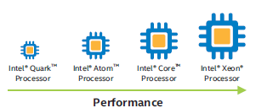
INTEL ARCHITECTURE FOR IOT
Low power and size SoC.
Take priority when lower power and size takes priority. Eg. Intel Galileo
Exceptional computing, graphics and media performance.
Low power and thermally efficient processors for applications performance in small form factor devices. Eg. Intel Edison
Highest computing power, exceptional computing density
Hardware application.

Slide 3
INTEL GALILEO GEN 2 Intel Quark SoC
Intel Quark is a line of 32-bit x86 SoCs by Intel, designed for small size and low power consumption, and targeted at new markets including wearable devices. Based on Intel Quark X1000, a 32 bit Intel Pentium processor-class system on chip the genuine Intel processor and I/O capabilities,of Intel Gen 2 provide full range of capabilities.
The technical specifications of Intel Quark SoC includes:
Processor Number | X1000
Cache | 16 KB
Instruction Set | 32-bit
Lithography | 32 nm
# of Cores | 1
# of Threads | 1
Processor Base Frequency | 400 MHz
Max Memory Size (dependent on memory type) | 2 GB
Memory Types | DDR3 800
Max # of Memory Channels | 1
Max Memory Bandwidth | 1.6 GB/s

Slide 4
USB Revision | 2.0
# of USB Ports | 3
Total # of SATA Ports | 0
Integrated LAN | 2
Integrated IDE | 0
General Purpose IO | 16
UART | 2
Max # of SATA 6.0 Gb/s Ports | 0
TDP | 2.2 W

Slide 5
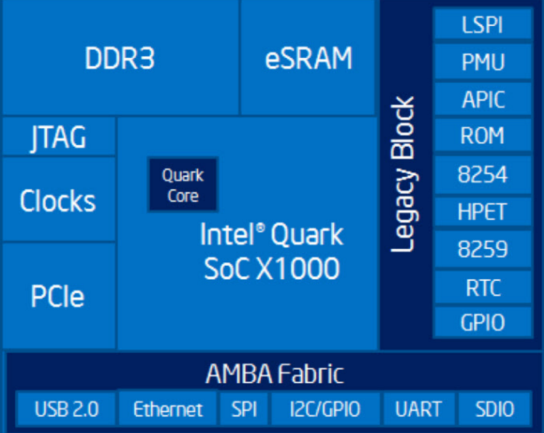
Block diagram of Intel Quark SoC

Slide 6
INTRODUCTION-Intel Atom
Intel Atom is the brand name for a line of ultra-low-voltage IA-32 and x86-64 CPUs (or microprocessors) from Intel.
Atom is mainly used in netbooks, nettops, embedded applications ranging from health care to advanced robotics, and mobile Internet devices (MIDs).
Intel Atom Architectures (x86 Microarchitecture):
Bonnell Architecture | 45 nm, low-power, in-order microarchitecture for use in Atom processors
Saltwell | 32 nm shrink of the Bonnell microarchitecture.
Silvermont | 22 nm, out-of-order microarchitecture for use in Atom processors
Airmount | 14 nm shrink of the Silvermont microarchitecture

Slide 7
Silvermount is a microarchitecture for low-power Atom processors used in systems on a chip(SoCs) made by Intel. Silvermont will form the basis for a total of four SoC families:
Merrifield and Moorefield – consumer SoCs intended for smartphones
Bay Trail – consumer SoCs aimed at tablets, hybriddevices, netbooks, nettops, and embedded/automotive systems
Avoton – SoCs for micro-servers and storage devices
Rangeley – SoCs targeting network and communication infrastructure.
The following are the characteristic features of Silverthrone:
A 22 nm manufacturing process
Consumer chips up to quad-core, business-class chips up to eight cores
Supports SSE4.2instruction set
Gen 7 Intel HD Graphicswith DirectX 11, OpenGL 4.0, and OpenCL 1.1support. OpenGL 4.0 is supported with 10.18.10.3945 WHQL drivers and later drivers. On Android, Silvermont graphics is OpenGL ES 3.0 certified.
4.5 and 7.5 W TDP mobile processors

Slide 8
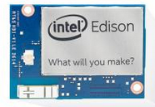
INTEL EDISON BRIEF OVERVIEW
The Intel Edison compute module is designed to lower the barriers to entry for anyone prototyping and producing IoT and wearable computing products.
It contains the core system processing and connectivity elements: processor, PMIC, RAM, eMMC Flash memory, and Wi-Fi/BT.
Intel Edison is a module that interfaces with end-user systems via a 70-pin connector.
No video input or output interfaces (MIPI CSI, MIPI DSI, HDMI, etc.). Internal image processing and graphics processing cores are disabled (ISP, PowerVR, VED, VEC, VSP, etc.).

Slide 9

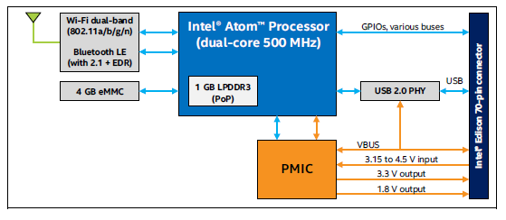
BLOCK DIAGRAM and BRIEF OVERVIEW
32-bit Intel Atom Processor Z34xx Series
40 general purpose GPIO
70-pin Hirose DF40 Series
Dual-band (2.4 and 5 GHz) IEEE 802.11a/b/g/n, BT 4.0 + 2.1 EDR, Dual-band onboard chip antenna or u.FL for external antenna
TI SNB9024 Power Management Integrated Circuit . subsystems for voltage regulation, A/D conversion, GPIOs, and RTC
POP memory -2 channel 32 bits @ 800 MT/sec
Block diagram of Intel Edison

Slide 10
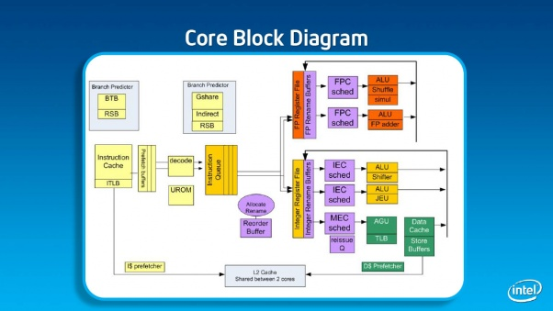
Silvermount Microarchitecture

Slide 11
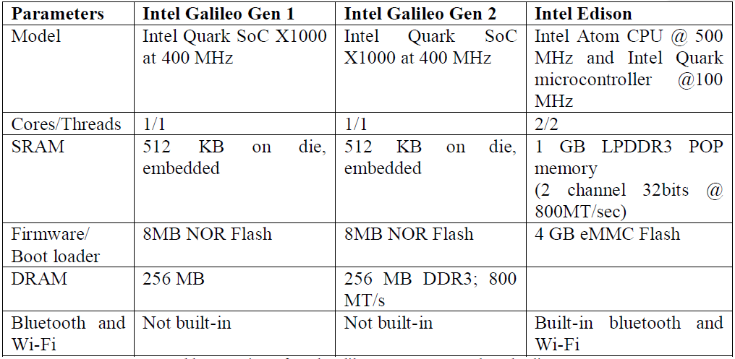
Comparison Table Between Intel Galileo-Gen1/2 and Intel Edison

Slide 12
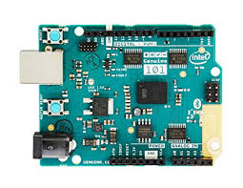
Intel Genuino (Intel Curie)
1. Onboard Bluetooth LE capabilities
2. 6-axis accelerometer/gyroscope

